Slide 1
UI/UX Fundamentals: A Deep Dive
Designing for User Delight

Slide 2
What is UI/UX?
Definition of UI: The visual elements of a product that a user interacts with.
Definition of UX: The overall experience a user has while interacting with a product.

Slide 3
Core Principles of UI/UX Design
User-Centered Design: Prioritizing the user's needs.
Simplicity: Keeping the interface clean and clutter-free.
Consistency: Maintaining a consistent visual style.
Accessibility: Designing for users with disabilities.
Feedback: Providing clear feedback to user actions.
Error Prevention: Anticipating and preventing user errors.

Slide 4
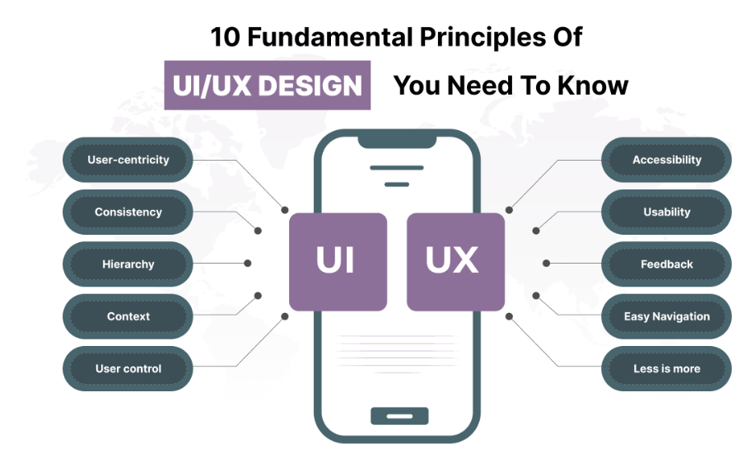

Slide 5
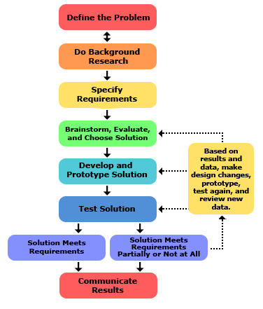
Design Tools and Workflow
Popular Design Tools: Figma, Adobe XD, Sketch, etc.
Design Workflow: Research, Wireframing, Prototyping, Visual Design, User Testing, Iteration.

Slide 6
Psychology and Human Factors
Cognitive Load: Minimizing mental effort for users.
Emotional Design: Eliciting positive emotions.
Perception and Attention: Guiding user focus.
Fitts' Law and Hick's Law: Optimizing interaction time.
Visual Hierarchy: Organizing information effectively.
Affordances and Signifiers: Making interactions clear.

Slide 7
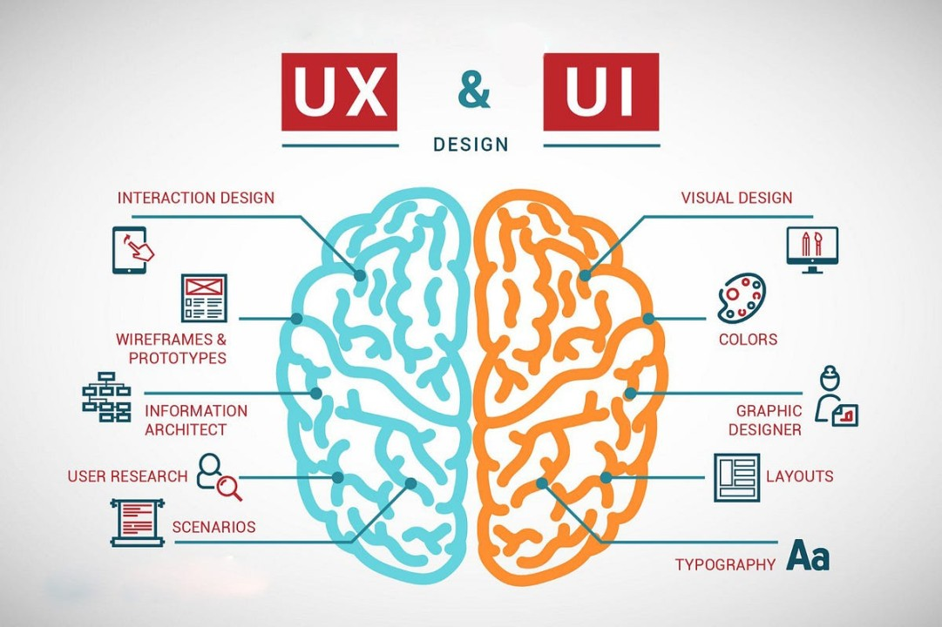

Slide 8
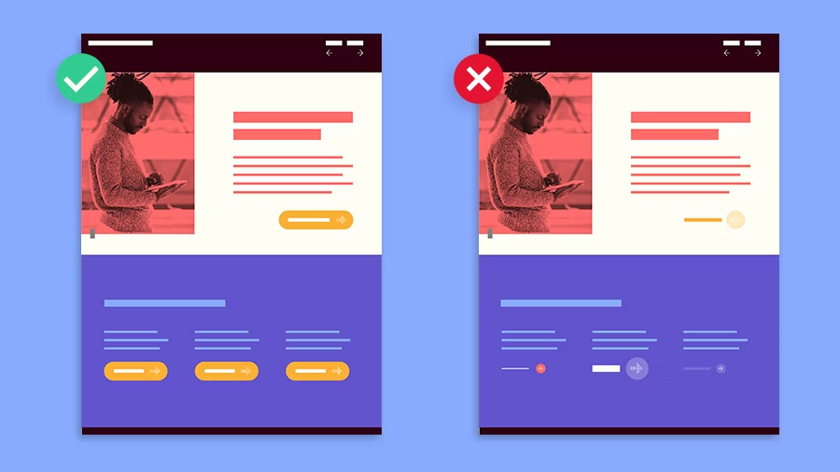
Layout and Composition
Grid Systems: Creating structured layouts.
Visual Hierarchy: Drawing attention to important elements.
Layout Patterns: Common layout structures (card, grid, list, etc.).
Responsive Design: Adapting to different screen sizes.

Slide 9

Typography
Font Families and Styles: Choosing the right fonts.
Typography Basics: Line height, letter spacing, word spacing.
Readability and Visual Appeal: Balancing aesthetics and functionality.

Slide 10
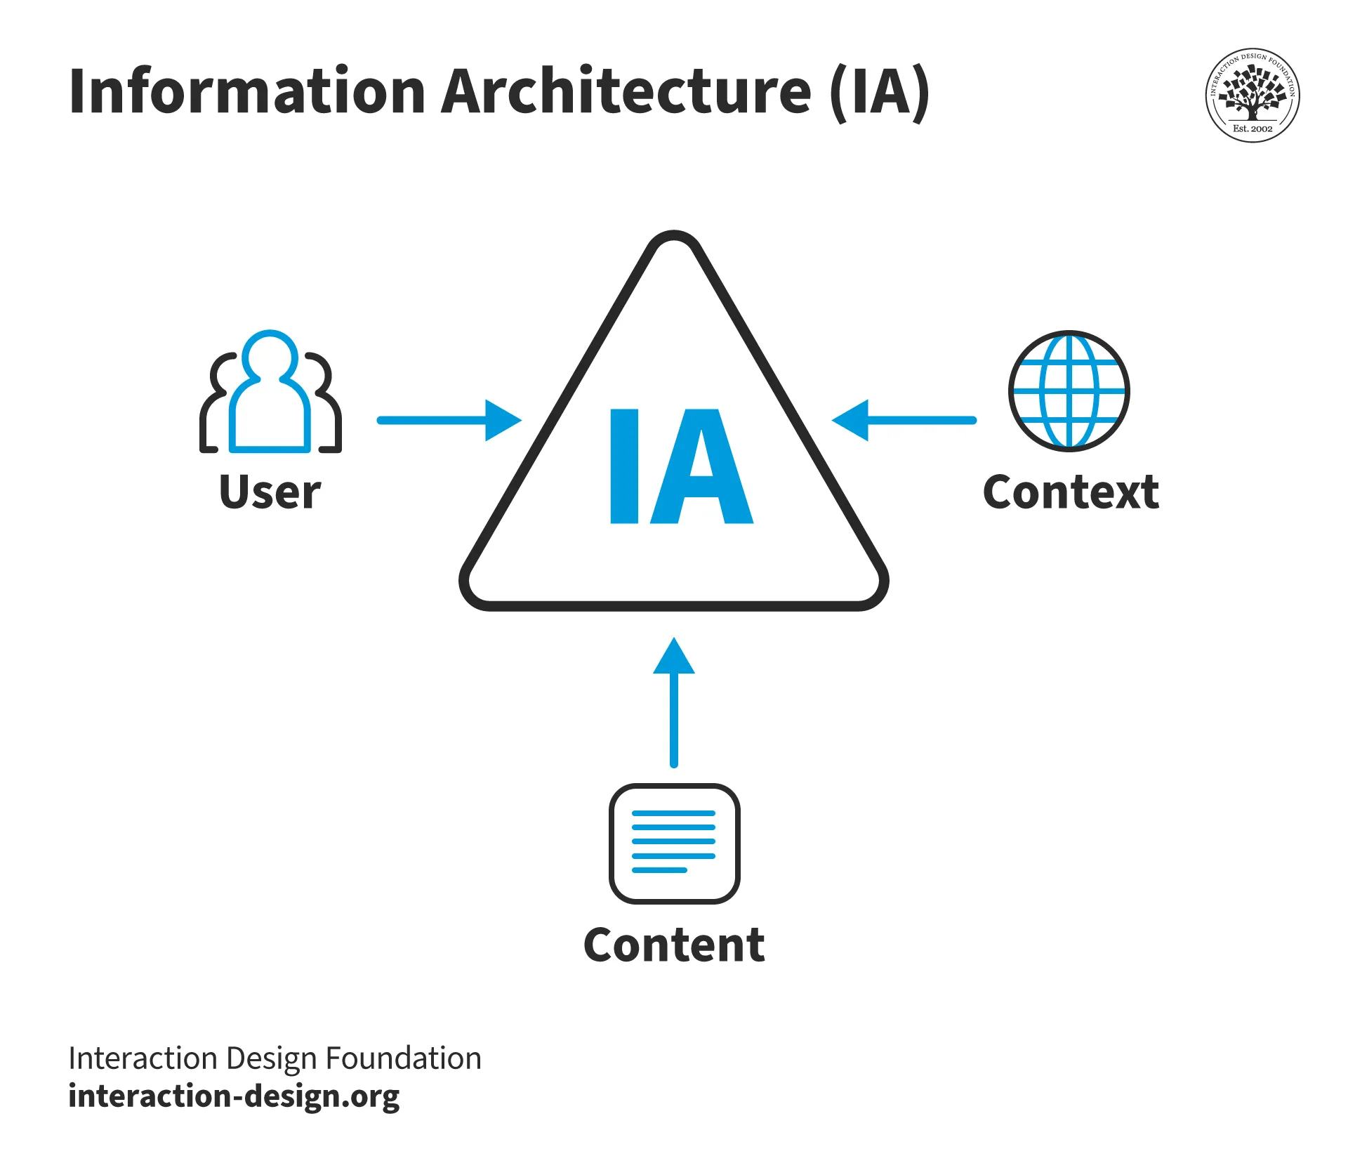
Information Architecture
Organizing Information: Creating clear information hierarchies.
Navigation Design: Designing intuitive navigation structures.
Content Strategy: Creating relevant and engaging content.

Slide 11
Color Theory
Color Psychology: Using color to evoke emotions.
Color Palettes: Creating harmonious color combinations.
Contrast and Visual Interest: Using color to draw attention.
Accessibility: Ensuring color choices are accessible to all users.

Slide 12
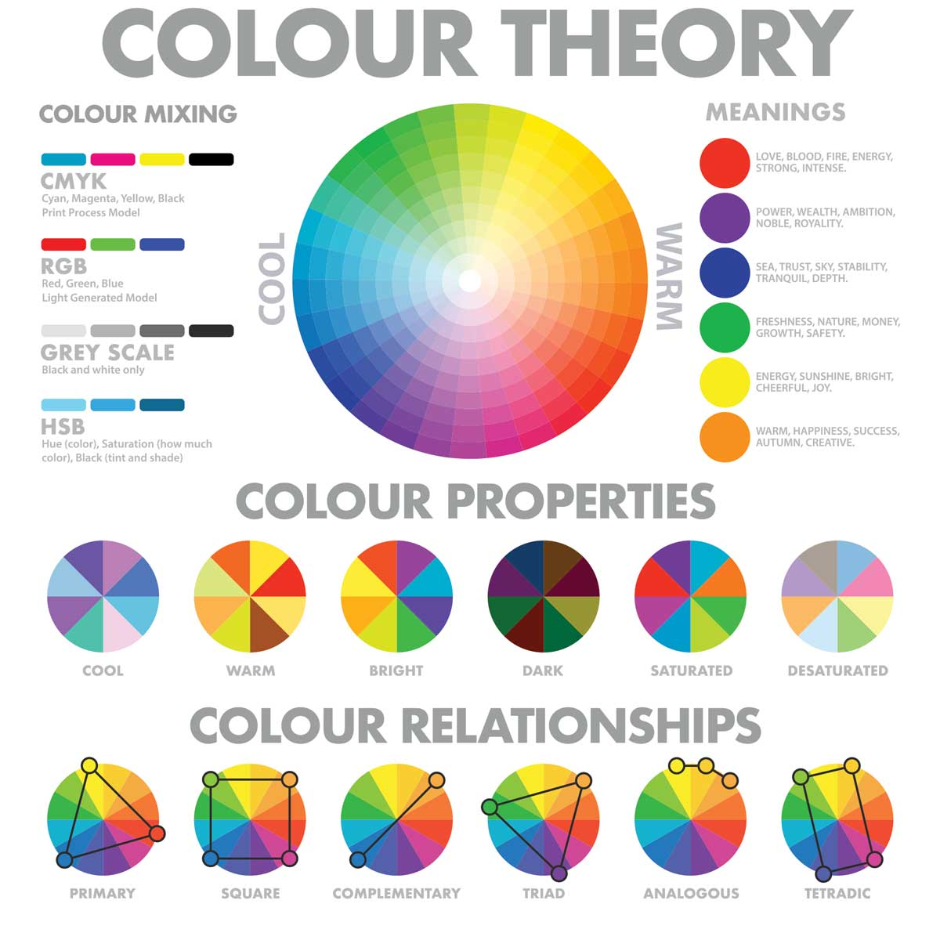

Slide 13
Design Process and Wireframing
Design Thinking Process: Empathize, Define, Ideate, Prototype, Test.
Wireframing: Creating low-fidelity and high-fidelity wireframes.
Best Practices: Focusing on core functionality, keeping it simple.

Slide 14
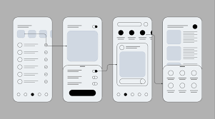

Slide 15
User Engagement and Ethics
User Engagement Strategies: Gamification, personalization, notifications.
Ethical Considerations: Privacy, security, accessibility, bias.

Slide 16
Design Alternatives and Future Trends
Minimalist Design: Less is more.
Material Design: Inspired by physical materials.
Neumorphism: 3D-like effects.
Voice Interfaces: Voice-controlled interactions.
AR/VR: Immersive experiences.
AI-Powered Design: Automated design tools.

Slide 17
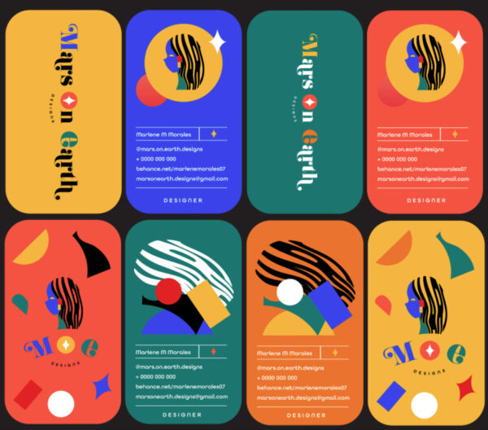

Slide 18
Thank You !

